Slide 1
Project Symphony:
Executive Alignment
Transforming organizational chaos
into coordinated harmony.
A Strategic Framework for Leadership.

Slide 2
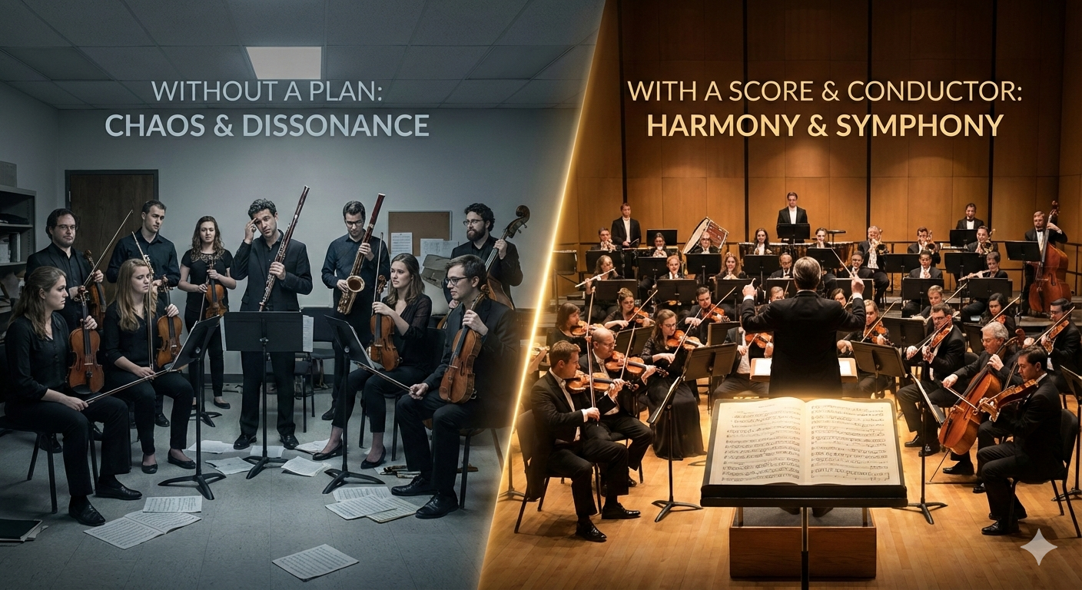
The Analogy: Setting the Foundation
Notes:
• Setting up the Analogy
- Imagine an orchestra preparing for a grand symphony performance
- The orchestra represents our organization
- Each musician symbolizes a different department or work center
- The conductor, like a leader, guides the musicians through the composition
• The Need for a Plan
- Without a well-defined score and conductor's guidance, chaos ensues
- Musicians play without synchronization
- Even expert musicians create confusion without a clear plan
- Each musician plays at their own pace and volume
- This leads to confusion, frustration and an unrecognizable melody.
• What a Good Plan Does
- Picture the same orchestra with a skilled conductor and precise musical score
- The conductor's baton signals the beginning, and the orchestra plays in harmony
- The conductor knows each instrument's role and when to bring it into composition
- Result: A captivating symphony that resonates with the audience
• Explain Analogy
- Conductor = Leaders who understand the org structure, work centers, and flow of work.
- Musical Score = Model or map of org workflow
- Musicians = Skilled employees in various departments or work centers
- Symphony = Our common work goals
**Executive Message:** Just as a conductor needs a musical score to guide musicians, leaders need a clear model of organizational workflow to guide work centers. Without this model, departments operate independently, leading to chaos and inefficiency.

Slide 3
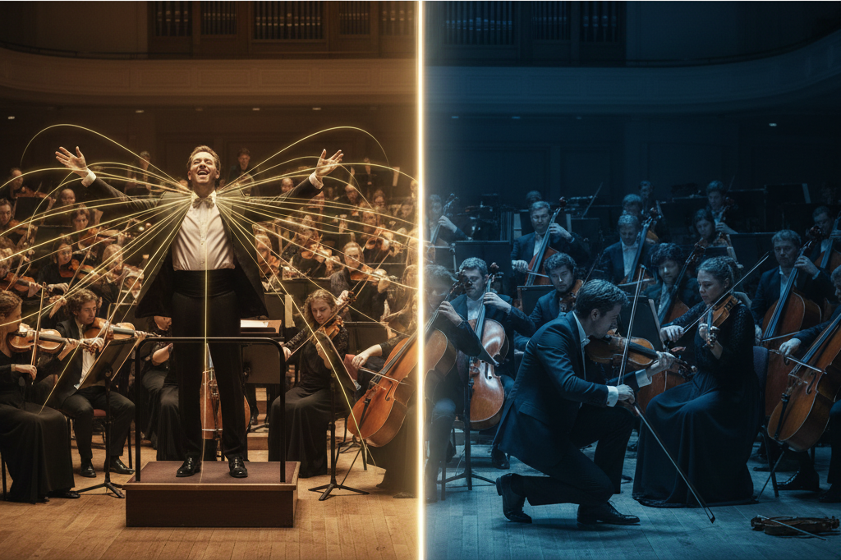
Leaders (The Conductor): System vs Local Thinking
Departmental Tunnel Vision
Improving tasks in isolation while ignoring the broader organizational needs.
Fragmented Performance
Polishing internal processes at the expense of the overall system’s health
Stagnant Resistance
Guarding established routines and resisting the cross-functional changes necessary for growth
Focus on the Organization
Prioritize the performance of the entire organization over the achievements of individual departments
Eliminate Local Optimizations
Remove departmental silos and "local wins" that create bottlenecks elsewhere
Flow Efficiency
Minimize handoffs and waste to ensure work moves from intake to delivery without friction
Continuous Improvement
Utilize feedback loops to drive constant, organization-wide evolution and refinement.
Notes:
• Conductor's Focus is Critical
- Great conductors focus on the entire orchestra, not a single musician
- Imagine a conductor focused only on one section or instrument
- Even worse: a conductor who leaves the podium to play a single instrument
- This is what happens when leaders focus on a single work center or department
• Openness to All Instruments
- We can play music on various instruments - harmonica, kazoo, violin
- The art is enriched as we master more instruments
- Leverage them appropriately toward the composition
**Executive Message:** Leadership requires system thinking. Executives must conduct the entire organizational orchestra, not get distracted by individual departmental performances.

Slide 4
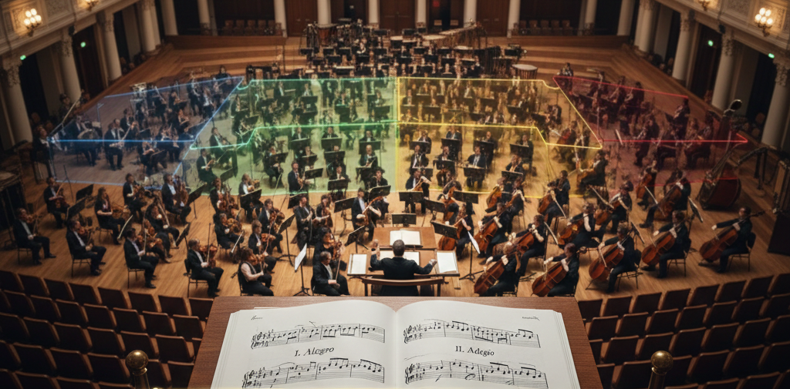
Categories: The Musical Sections
Work Intake
Strategic Evaluation
Engagement Support & Review
Common Goal & Definition of Work Flow
Engineering /
Development
Implementation
Training
Notes:
• Orchestra Layout and Symphony Structure
- Orchestra is divided into sections, each with specific instruments and roles
- Convenient for our analogy, a symphony has four movements
- Likewise, organizations have different sections or categories of work
- We need to understand and illustrate how they relate to each other
• Common Goals, Not Competition
- All sections work toward the same common goals
- They aren't in competition with each other
- To prove this, we must understand and demonstrate their relationships
**Executive Message:** Organizational sections must work harmoniously toward shared objectives. The four-movement structure provides a framework for understanding how different areas of the business interconnect.

Slide 5
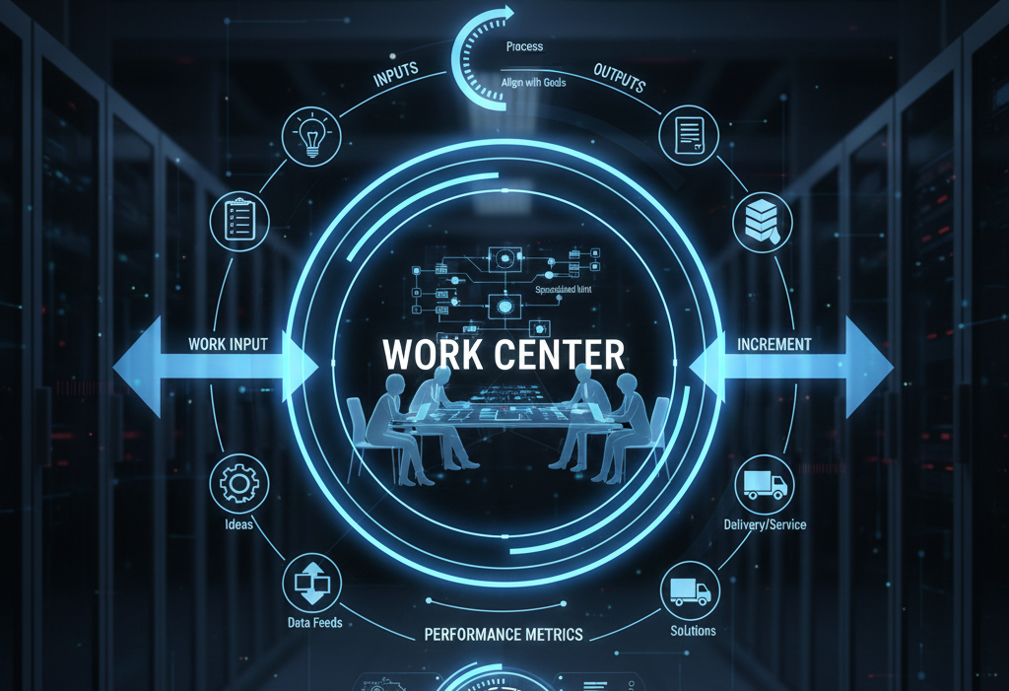
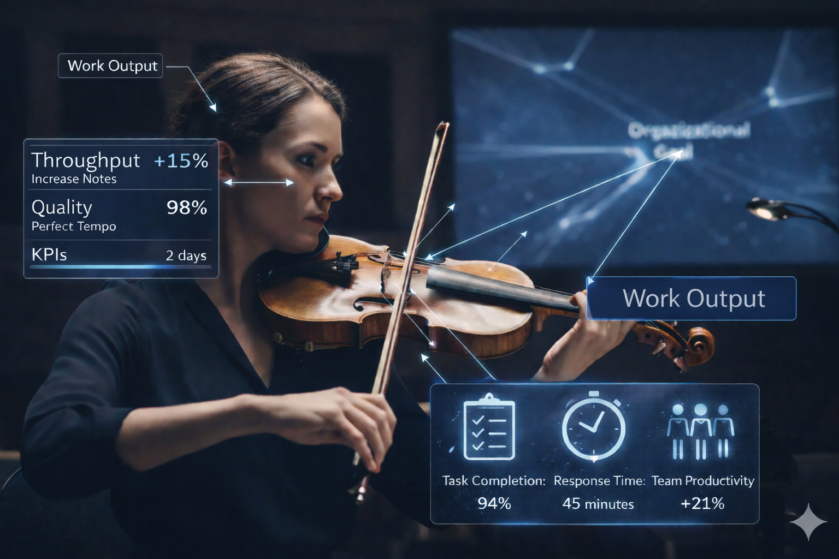
Notes:
• Work Centers
- A work center is a specialized unit in an organization focused on specific tasks and goals
- Sometimes a department, or team, or group of people from different departments
- Organized to work towards specialized tasks and objectives
- Structured in such a way that they have clearly defined handoff of work in both what goes into them, and what goes out of them.
• Purpose
- It is a point where work can be planned for
- Designed with the ability for the organization to measure and improve and work incrementally
- They have Key Performance Indicators and other Metrics as feedback loops
- Inside the work center, there are different processes at, tuned for the specialized tasks they perform
- But all internal processes must align with the organizational goals
**Executive Message:** Work centers are the fundamental building blocks of organizational performance. Properly defined work centers enable planning, measurement, and improvement across the entire system.

Slide 6
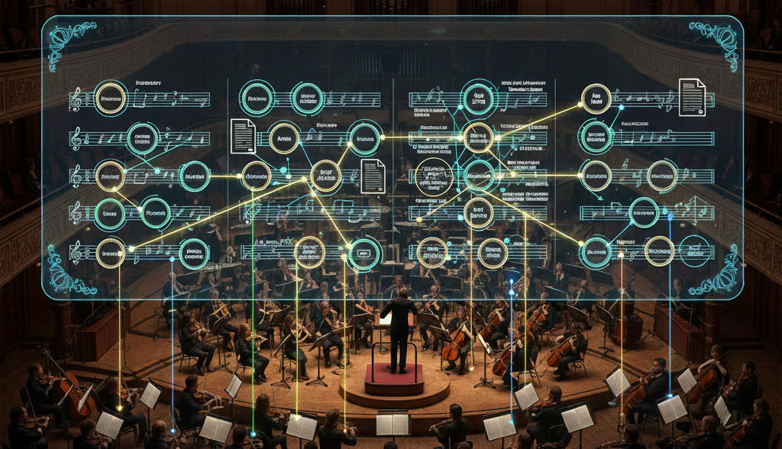
The Model: The Musical Score
Notes:
• Creating the Organizational Score
- Model work centers within each section or movement
- Creating a musical score for the organization
- Show how each musician plays their part in the composition
- They know what to play, when to play it, and how to play it
- Clear understanding of their movement or section and how their work relates to others
**Executive Message:** The organizational model serves as the "score" that enables coordinated performance. Every work center understands their role, timing, and contribution to the overall composition.

Slide 7

1st Movement (Allegro): Work Intake & Strategic Evaluation
Notes:
• Energetic and Thematic Foundation
- Similar to a symphony's energetic First Movement (Allegro)
- The Work Intake & Strategic Evaluation category serves as the dynamic foundation of the operational symphony.
- Introduces work requests and proposals
- Sets direction and purpose
• Strategic Gatekeeper Function
- Project strategy work center acts as gatekeeper
- Ensures projects are feasible and strategically aligned
- Ensures work delivers value to the organization
- Makes informed decisions about resource investment for long-term success
**Executive Message:** The first movement establishes strategic direction and ensures all work aligns with organizational goals before resources are committed.

Slide 8
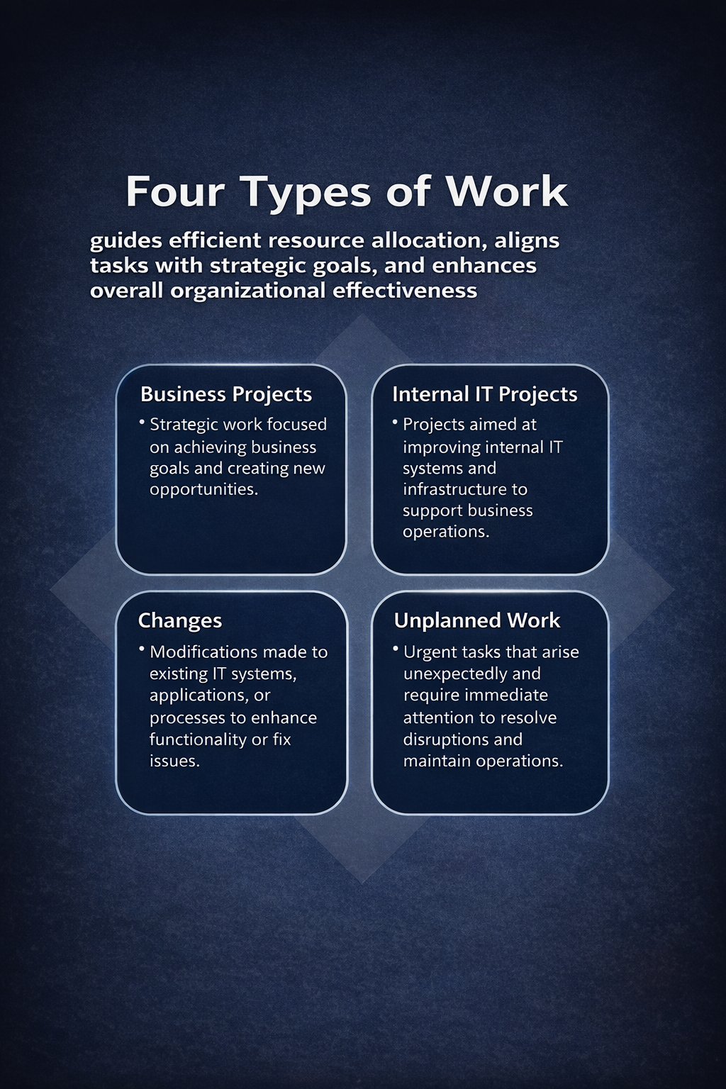
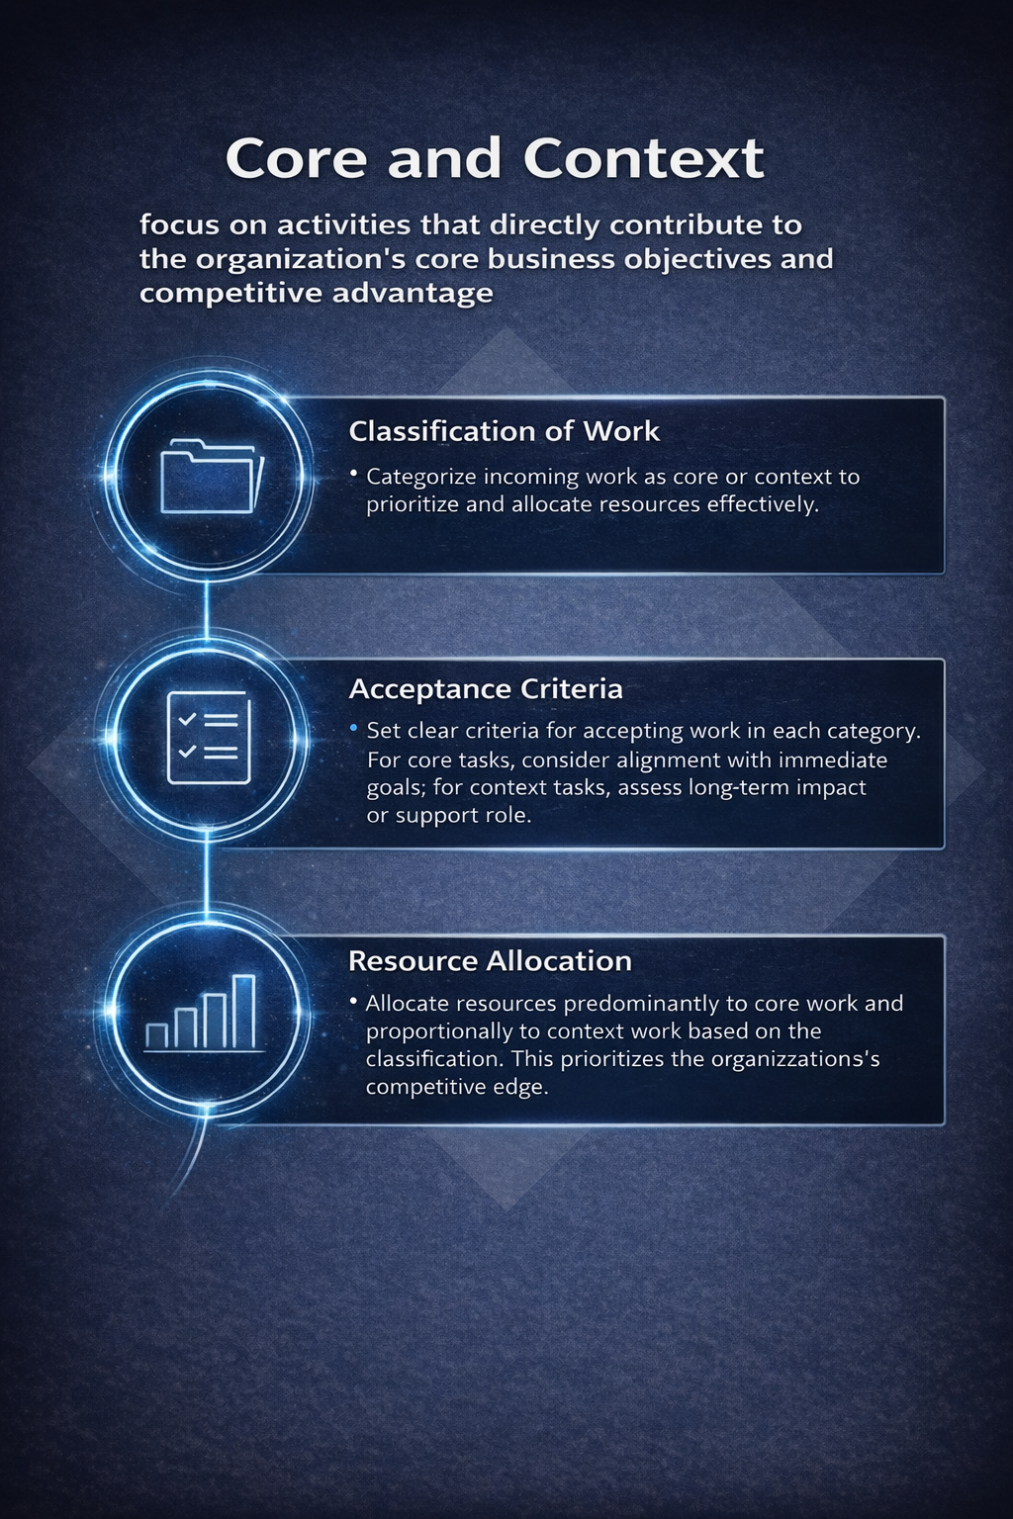
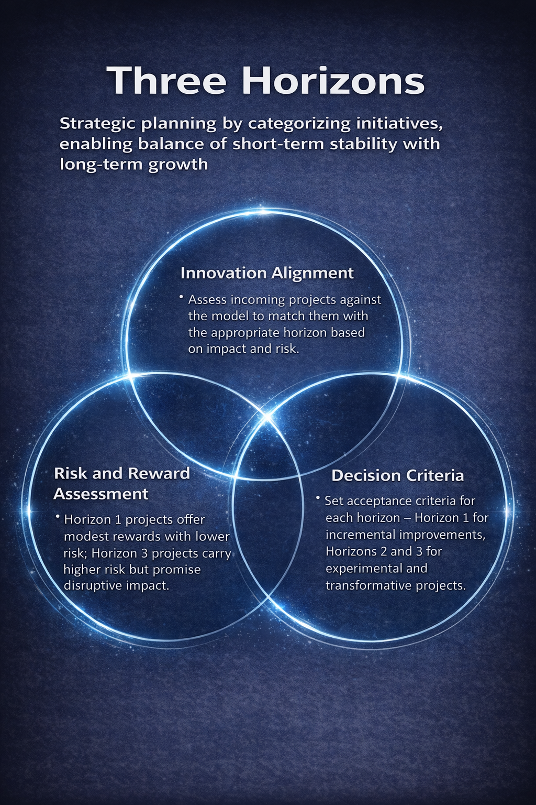
Methodologies: Instruments at Intake
Notes:
• Benefits of Common Methodologies
- Provide common language for discussing work
- Proven resources (like sheet music) help get started
- Help others get involved quickly as they may already be familiar
• Work Categorization
- What type of work is this?
- Is it core or context?
- Does it align with innovation strategy?
- Is our innovation focus correct with our risk and goals?
**Executive Message:** Standardized methodologies serve as organizational "instruments," providing proven approaches and common language that accelerates collaboration and reduces risk.

Slide 9

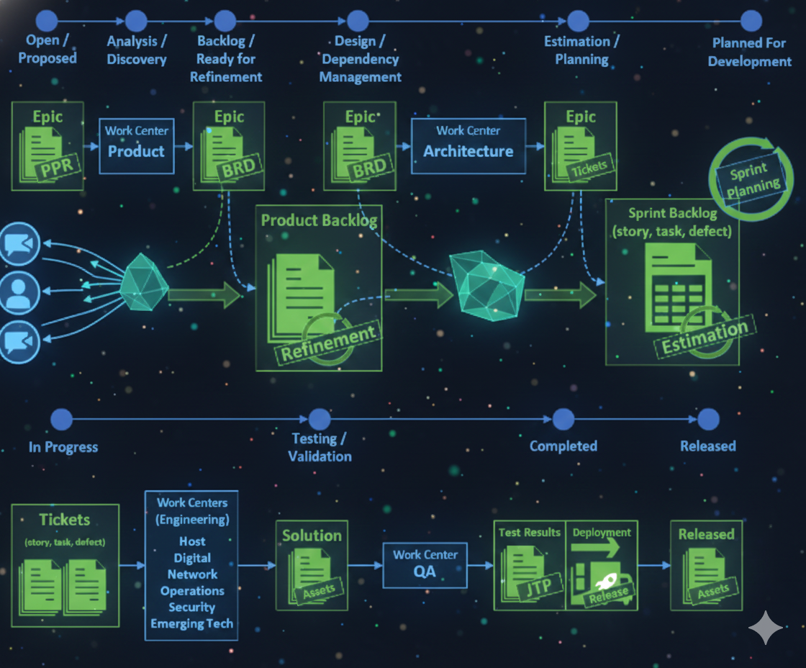
2nd Movement (Adagio/Andante):
Engineering & Development
Notes:
• Deliberate and Methodical Phase
- Similar to the deliberate and expressive Second Movement in a symphony (Adagio or Andante)
- This phase signifies a focused and methodical phase in the workflow
- Shifts from intake to detailed planning and execution
- Allows meticulous craftsmanship and creative collaboration
• Technical Nature and Visualization
- Highly technical stage requiring clear visualization
- Like this presentation uses analogy to explain concepts
- Methodologies must harmonize as work relates to each other
**Executive Message:** The development phase requires careful orchestration of technical resources and methodical execution, moving from strategic vision to detailed implementation.

Slide 10

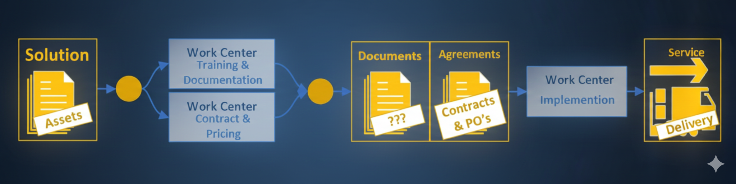
3rd Movement (Scherzo/Minuet): Implementation & Training
Notes:
• Bringing Work to Life
- Like Scherzo or Minuet, infuses liveliness into the symphony
- Contrasts with earlier emotional depth, adding playfulness and rhythm
- Likewise, this phase breathes life into work, moving from meticulous development
- Celebrates completion of work
• User Enablement
- This phase introduces users to new capabilities
- Ensures users are ready to use capabilities effectively
- Just as the Scherzo adds dynamics, this phase energetically rolls out solutions with spirit and precision
**Executive Message:** Implementation transforms development work into organizational capability, requiring energetic change management and user enablement to ensure adoption.

Slide 11

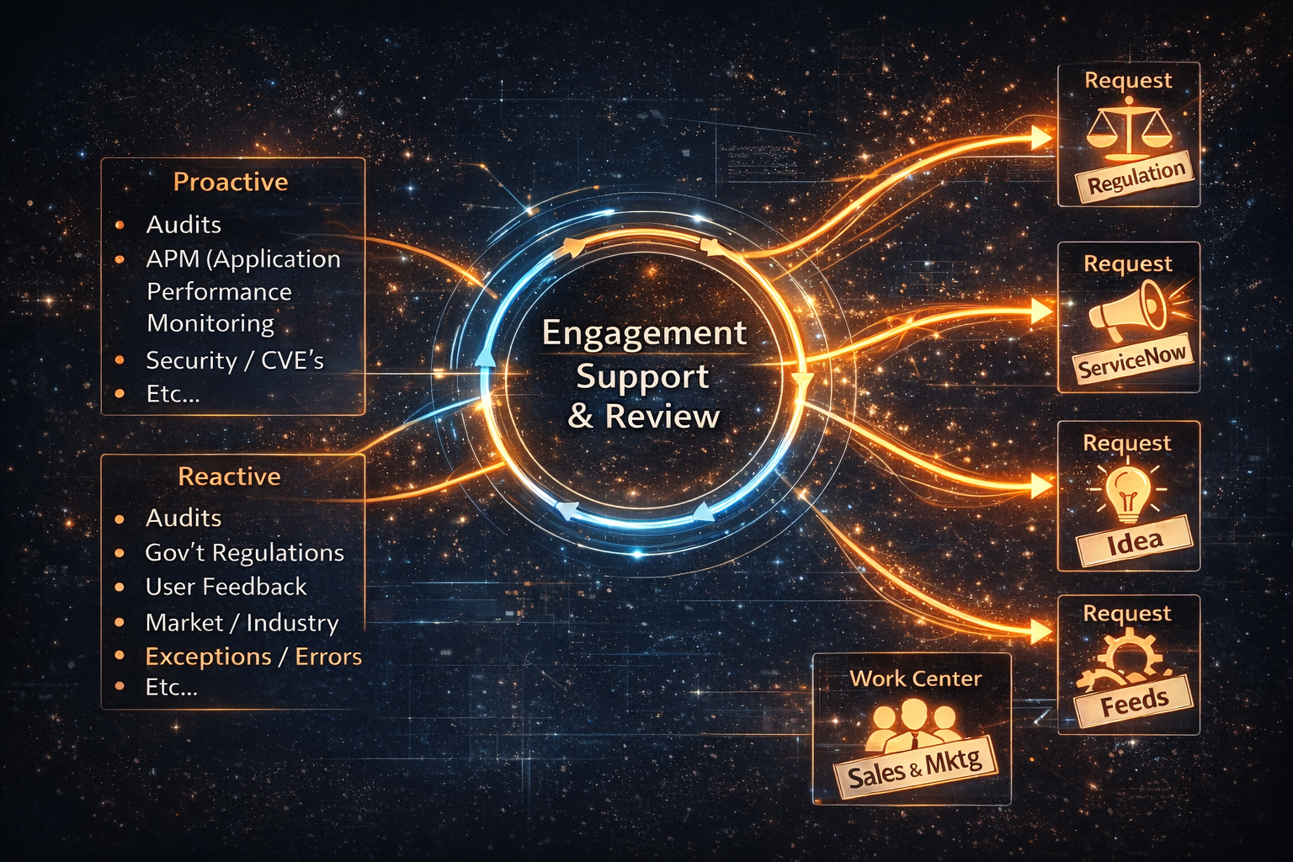
4th Movement (Allegro/Finale):
Engagement, Support & Review
Notes:
• Thrilling Climax and Resolution
- Like Allegro or Finale, this phase represents symphony's thrilling climax
- Fast-paced section bringing resolution and triumph, or sometimes intense drama
- Embodies energetic culmination
- Secures ongoing success and growth
• Lasting Impact
- Peaks the symphony achievement
- Elevates achievements and shapes lasting impact
**Executive Message:** The final movement ensures sustained value realization and continuous improvement, creating lasting organizational impact from completed initiatives.

Slide 12

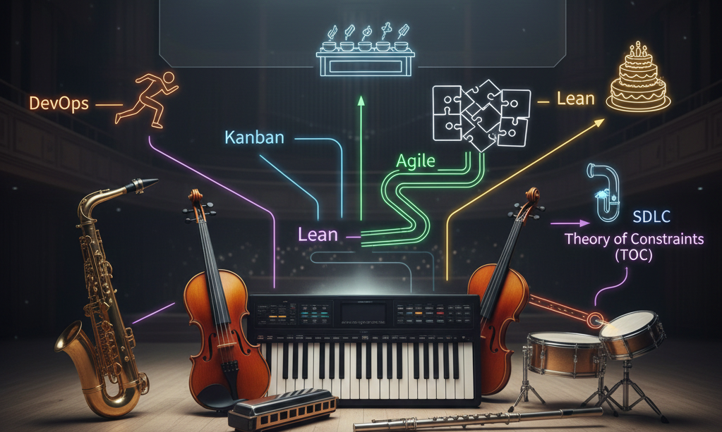
Methodology Integration
Notes:
• Proven Tools for Appropriate Use
- We've already talked about the benefits of common methodologies or instruments
- Taking advantage of proven resources
- Giving us a common language to talk about the work
- Helping others get involved quickly
- Every methodology has its place and application level
- Not every instrument solves every problem
- You wouldn't use a saxophone in a string quartet
- Important to understand what they are and how they help
• Practical Analogies for Common Methodologies:
- TOC: Finding bottleneck in water pipe for smooth flow
- DevOps: Well-coordinated relay race with seamless collaboration
- Lean: Streamlined road trip removing unnecessary stops
- Agile: Flexible puzzle pieces adapting to evolving picture
- Kanban: Buffet restaurant with just-in-time replenishment
- Scrum: Coach optimizing each relay leg performance
- SDLC: Recipe for structured software development
**Executive Message:** Different methodologies serve as specialized instruments in the organizational orchestra. Success comes from selecting and coordinating the right tools for each situation.

